Slide 1
Introduction to programming using Python
Shiva Kambala

Slide 2
Shiva Kambala
Former Systems Engineer at Infosys |MBA in Finance | Entrepreneur (Agriculture)

Slide 3
Course topics
Introduction to programming using Python – Day one
01 | Getting started
02 | Displaying text
03 | String variables
04 | Storing numbers
05 |Working with dates and times (contd...)

Slide 4
Course topics
Introduction to programming using Python – Day one
06| Making decisions with code
07| Complex decisions with code

Slide 5
Course topics
Introduction to programming using Python – Day Two
08 | Repeating events
09 | Repeating events until done
10 | Remembering lists
11 | How to save information in files
12 | Reading from files (contd...)

Slide 6
Course topics
Introduction to programming using Python – Day Two
13 | Functions
14 | Handling errors

Slide 7
Setting expectations
Target Audience
People new to programming
Students
Career Changers
IT pros
Anyone with an interest to learn code

Slide 8
If you want to follow along....
Install Visual Studio Express
Install Python tools

Slide 9
Getting Started
How and Why?

Slide 10
Why learn to code ?
Programming is a powerful tool you can use to solve all kinds of problems.
What do you want to do ?
- Build a phone app that help you find directions
- Calculate how much money you need to buy a car
- See what people are saying about your business on social media.

Slide 11
Why python?
There are lot of different programming languages out there
Python is one of the easier ones to learn
There are lot of free tools out there you can use to code or learn Python
There are lot of different ways to use Python code

Slide 12
And as a bonus........
Once you learn to code in one programming language, it will be easier to learn another and another .....
C#
Java
C++
??

Slide 13
Does anyone use Python?
Industrial light and magic uses python to help with image processing and lighting effects
ForecastWatch.com uses python in weather forecasting
DevNet uses Python to aggregate news feed
A student in England made a desktop Dinosaur roar, every time it was mentioned on Twitter, with a Rasberrypi.

Slide 14
But, Let’s be clear about something........
You won’t learn enough in this course to add graphics to the next big super hero movie.
You will learn enough to start solving real world problems using code.
OR to just having some fun.

Slide 15
So, how do I get started?

Slide 16
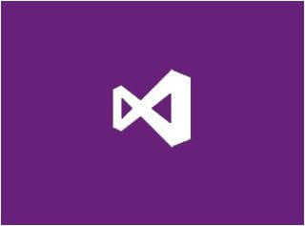
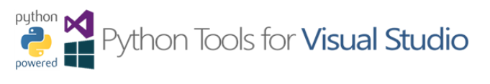
You will need to install software on your PC/Laptop
There are lot of different tools out there to write Python code
We will use Visual Studio + Python tools for visual studio

Slide 17
The installation steps are listed in Python tools for Visual Studio website.
Install Visual Studio 2013 for desktop(free) .
Install Visual Studio 2013 update 3 ,so that you will have latest features.
Install Python tools for visual studio.
Install Python 3.4 interpreter

Slide 18
Geek tip!
There are actually lot of different flavours of Python.
IronPython,IPython,Cpython,Jython,Anaconda,PyPy.
We will be using Cpython interpreter with Python3.4
So, If you copy code from a website and it doesn’t work, don’t panic! It might be a different flavour of Python

Slide 19
How do I know I installed everything correctly?
There is a tradition among
Programmers.
We always test our installation
By writing the same program:
Hello World!

Slide 20
DEMO
Creating your Hello, World! Program.

Slide 21
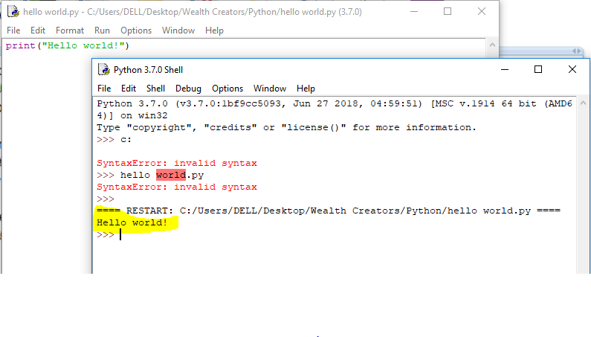
You have now created your first application.
print(‘Hello World!’)

Slide 22
Best practices!
Pick up good habits right away.

Slide 23
Best practices!
Pick up good habits right away!
Comments in your code help you or someone else understand :
- What your code does!
- Why chose to do something particular way!
- Anything that might be helpful to understand if I refer back to my code later.

Slide 24
In python we use # to comment our code.
# My first Python application
# Shiva Kambala
# hello world.py
# print function displays a message on the screen
print(“hello world”)

Slide 25
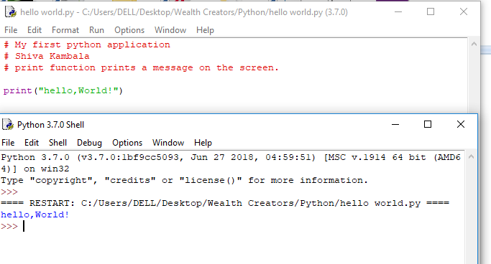

Slide 26
Congratulations, you are a coder now.

